Slide 1
Provide Safe and Livable Neighborhoods
A living document exchanged between neighborhood leaders and stakeholders

Slide 2
East 4th Street Overflow Services
Needs and Goals Discussion
  East 4th Serves the Region
  Miscellaneous Aerials
  Reduced Emergency Service Calls
  Safe Zones
  Transportation
  Attractive Public Spaces
  Substance Abuse
  Neighborhood Communication
Business Community
  Cliental Comfort
  Fair Taxation Policies
Service Community
  Safe Access
  Effective Needs Management
  Engaged Organizations
Government Community
  Public Relationships
  Highest and Best Land Use
  Sustainable Communities
  Intelligence Led Policing
Remember
  We are good at this
Proposal Overflow Sites
  VOA updates
  Catholic Charities
  Lot and alley behind VOA/West
  Morill St other side of Wells overpass
Conclusion
  Regular Neighborhood Meetings
  Community Pillars
  Council Resolution
  Site Requirements
    Artistic Rendering
    Site Sketches
Appendix
  Research Links
  Reno Initiative for Shelter and Equality (RISE)
  Volunteers of America

Slide 3
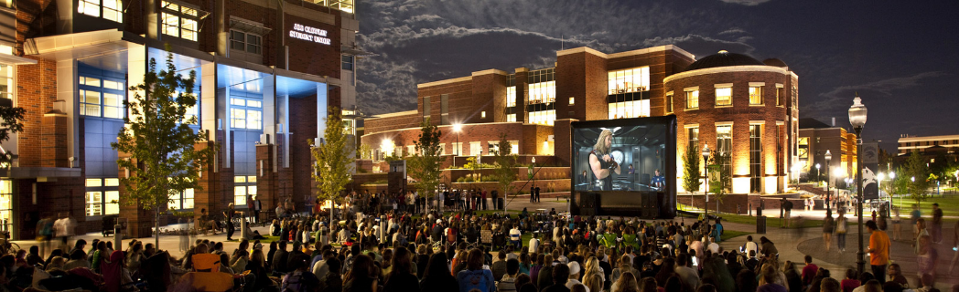
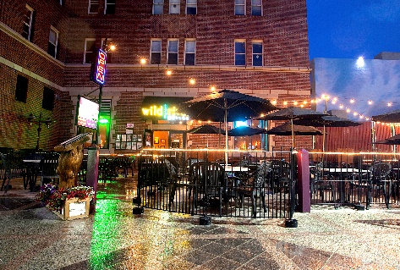
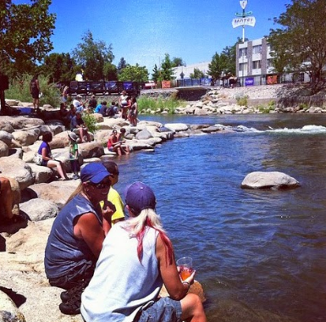
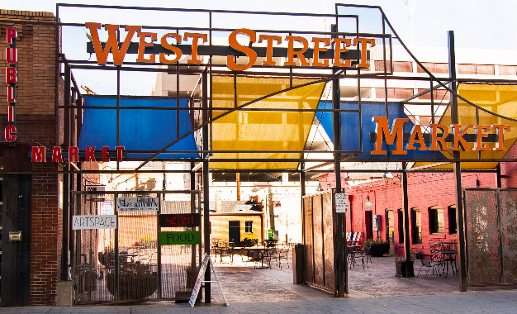
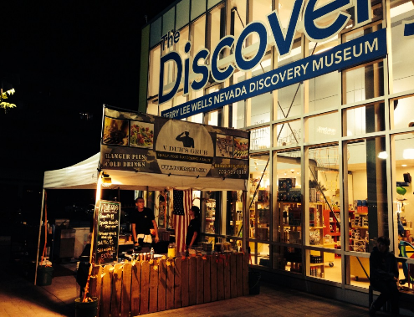
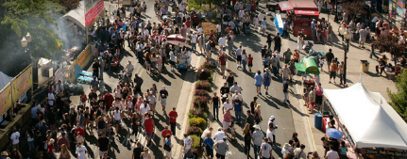
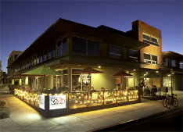
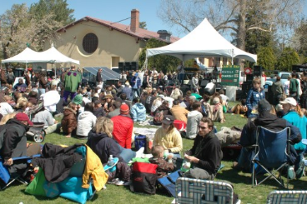
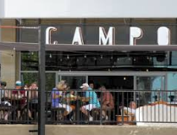
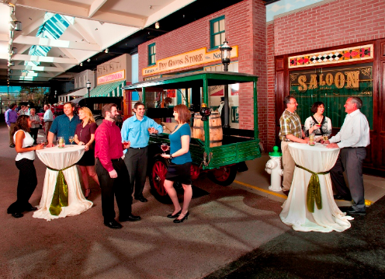
We are Good at Public Space
Remember

Slide 4
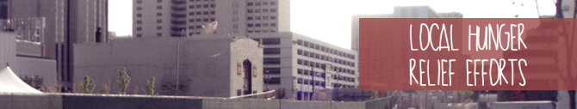

East 4th Street Serves the Region
Needs and Goals Discussion
  Gathering of Regional Service Providers
  Reduced Emergency Service Calls
  Safe Zones
    Safe Environment for the Vulnerable
    Public Feeding
    Personal Property Protection
    Families without Homes
    Bathroom Facilities
    Clean Water
  Social Fabric to Engage
    Transportation
    Substance Abuse
    Inadequate Housing
  Attractive Public Spaces
    Blight Reduction
    RTC Upgrades
    Cleanup
  Neighborhood Communication
    Monthly Meetings Tapering to Quarterly (Explore the West of Wells neighborhood group)

Slide 5
Community Assistance Center
Appendix

Slide 6
Wells Overpass and Neighborhood View
Appendix

Slide 7
Multiagency Facility + Solution Options
Proposal Overflow Sites
Volunteers of America Updates
335 Record Street - 007-313-27
315 Record Street - 007-313-28
Catholic Charities of Northern Nevada
335 Record Street - 007-313-27
315 Record Street - 007-313-28
Lot and alley behind VOA/West
0 Valley Rd - 008-350-10
Morill Street other side of Wells overpass
Private Ownership

Slide 8
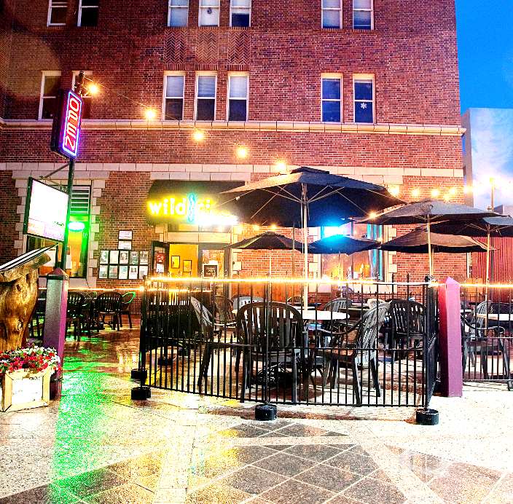

Energizing Business Environment
Business Community
Clientele Comfort
Secure public spaces
Fair Taxation Policies
Properly serve those facing poverty with shared regional tax burden for shared regional challenges.

Slide 9
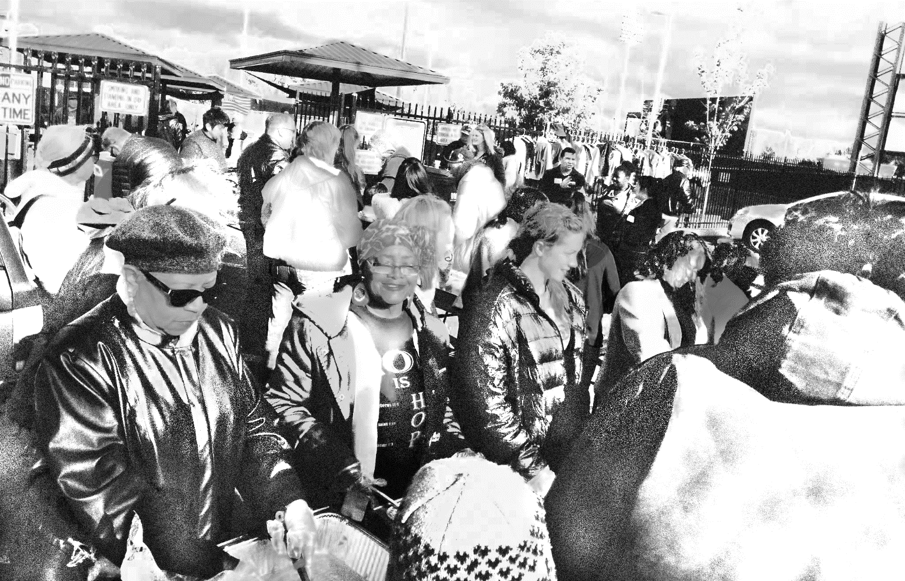
Safe and Empowering Relationships
Services Community
Community Orgs
__________________________
__________________________
__________________________
__________________________
Spiritual Groups
__________________________
__________________________
__________________________
__________________________

Slide 10
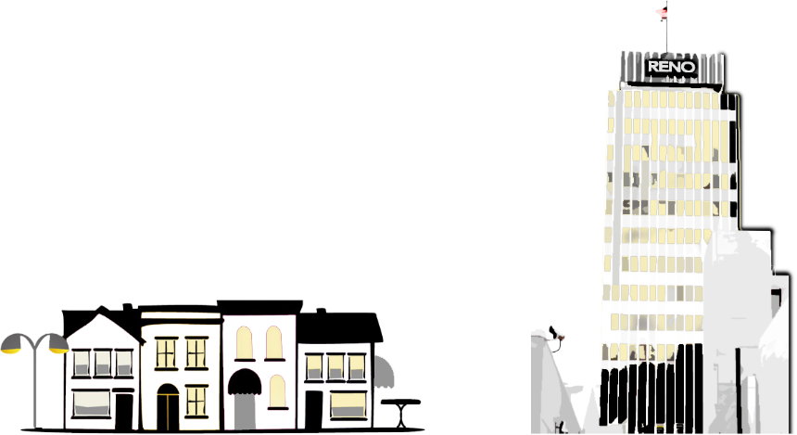
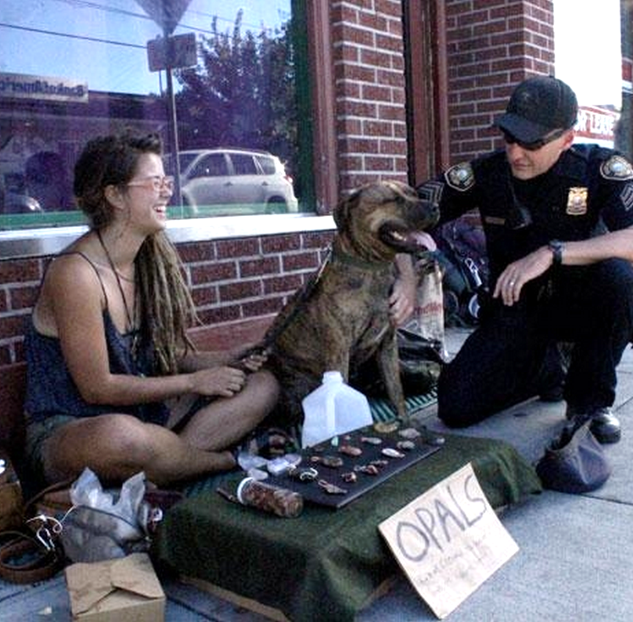
Facilitation and Security
Government Community
Public Relationships
Highest and best land use
Adequate services for our population
Sustainable Communities
Add to the value of our region
Intelligence Led Policing
Relationships
Community Policing Partnerships
Data and Evidence
Case Studies
Long Term Goals
Crime Prevention
Problem Solving

Slide 11

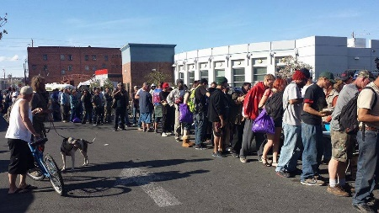
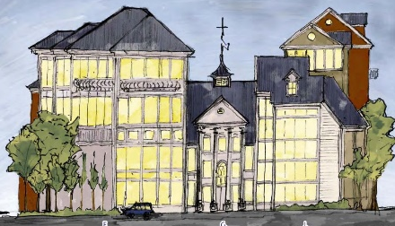
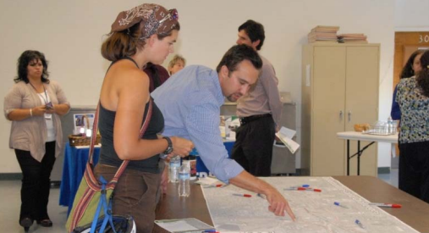
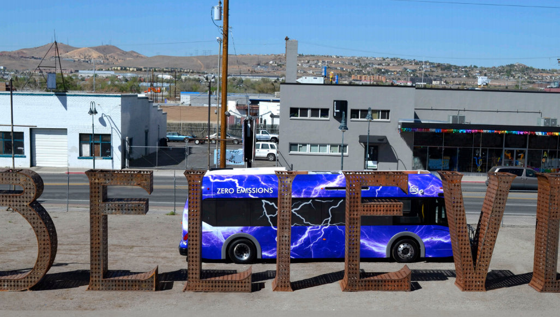
Where do we go from here?
Conclusion
Regular Neighborhood Meetings
Monthly to start
Quarterly once communications are established
First Meeting
Logo Concept Draft
May 28th 5:30pm
Neighborhood Stakeholder Meeting
Identify Overflow Site
Create Renderings
Overflow site
Mobile option
Club house
Kitchen support
Map of services
Map of housing
Include
All
Stakeholders
Include
RTC
Efforts
__________________________
__________________________
__________________________
__________________________
__________________________
__________________________
__________________________
__________________________
__________________________
__________________________
__________________________
__________________________
__________________________
__________________________
__________________________
__________________________

Slide 12
Research Links
Appendix
East 4th Street Walking Tour - http://renohistorical.org/tours/show/7#.VVEUIPlVhBc
Positively 4th Street - http://www.positively4thstreet.org/
RTC bus - http://www.rtcwashoe.com/streetshighways/documents/SummaryReportCorridor.pdf#page=2
East 4th Street TOD Corridor Plan - http://www.reno.gov/home/showdocument?id=43526
Men’s Shelter, Reno - http://www.voa-ncnn.org/mens-shelter-reno
Hud Listed Shelters - http://portal.hud.gov/hudportal/HUD?src=/states/nevada/homeless/shelters
Volunteers of America Northern Nevada - http://www.voa-ncnn.org/northern-nevada
Catholic Charities of Northern Nevada - http://ccsnn.org/
West of Wells Neighborhood Group - http://www.westofwells.com/
RTC RAPIC Transit 4th St/Prater - https://4thprater.files.wordpress.com/2011/07/narrative4thprater.pdf

Slide 13
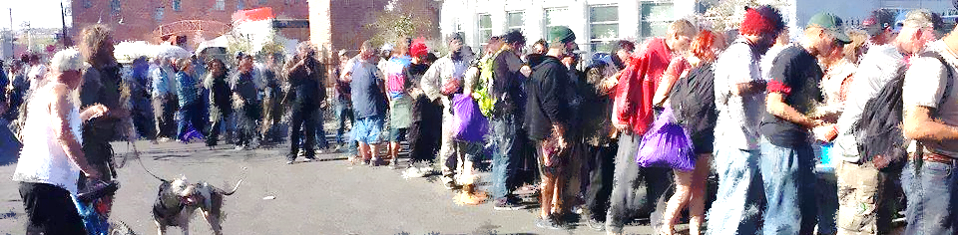
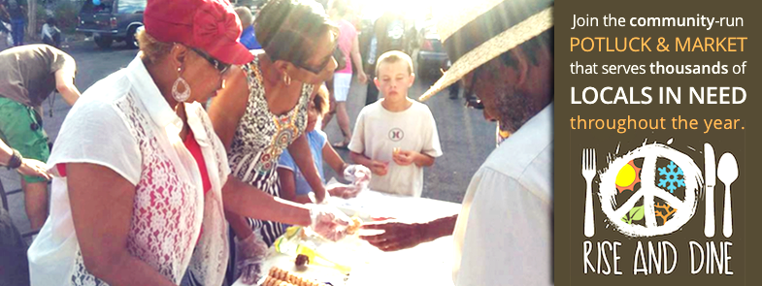
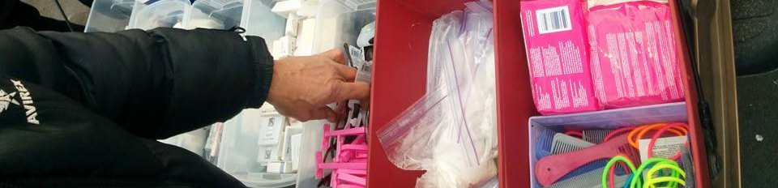

Reno Initiative for Shelter and Equality
Current Service Providers
RISE and Dine
With the help of our supporters, RISE feeds and clothes thousands of Reno’s most poverty-stricken throughout the year.
Volunteer Programs
Over 500 people a year team up and help run RISE programs
Free Store
RISE distributes clothing and hygiene items with a value of over $10,000 to those needing emergency aid each year.
Community Relationships
33 companies have contributed to RISE efforts to bridge the gaps between our citizens.

Slide 14
Volunteers of America
Current Service Providers
Men's Shelter
Volunteers of America's Men's Shelter for homeless men.
Family Shelter
An emergency shelter for families located at Reno's Community Assistance Center.
Affordable Housing for Seniors
Volunteers of America manages for seniors 62 and older.
Women's Shelter
The Volunteers of America Women's Shelter provides emergency shelter to homeless women.
Mental Health Support Services
ReStart is a Volunteers of America program offering clinical and non-clinical services for eligible individuals and families who are homeless or at risk of homelessness and have a mental illness

