Slide 1

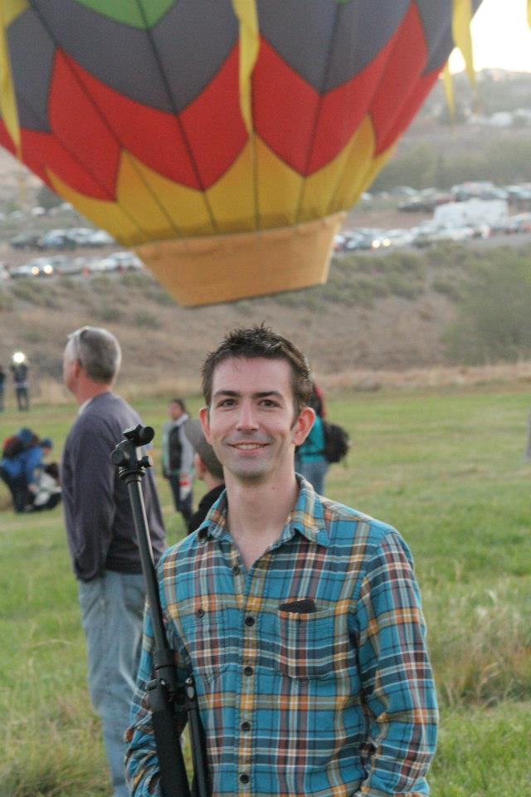
Presenter
Jay Kolbet-Clausell
775-391-0742
jay@renosparks.org

Slide 2

Know the Data
RenoSparks.org

Slide 3
Deal with People
Katrina

Slide 4
Care for the Streets
NABs

Slide 5
Know the Data
I’m available to help
Wednesday - Friday

Slide 6
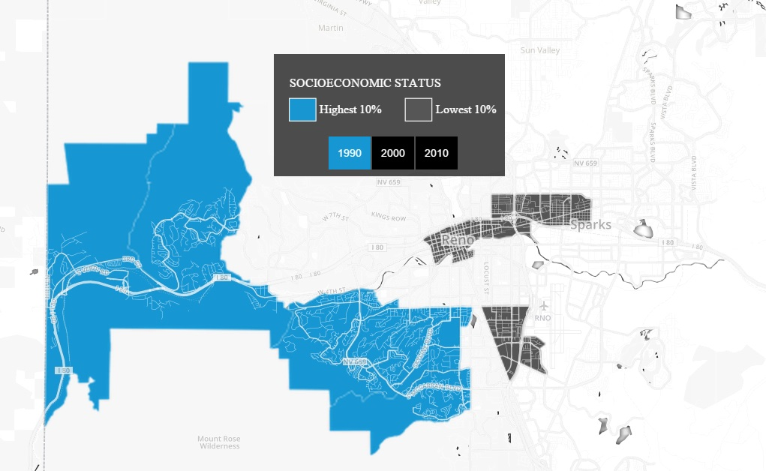
Urban.org
Source:
http://datatools.urban.org/features/ncdb/top-bottom/index.html#7/42.004/-94.026

Slide 7
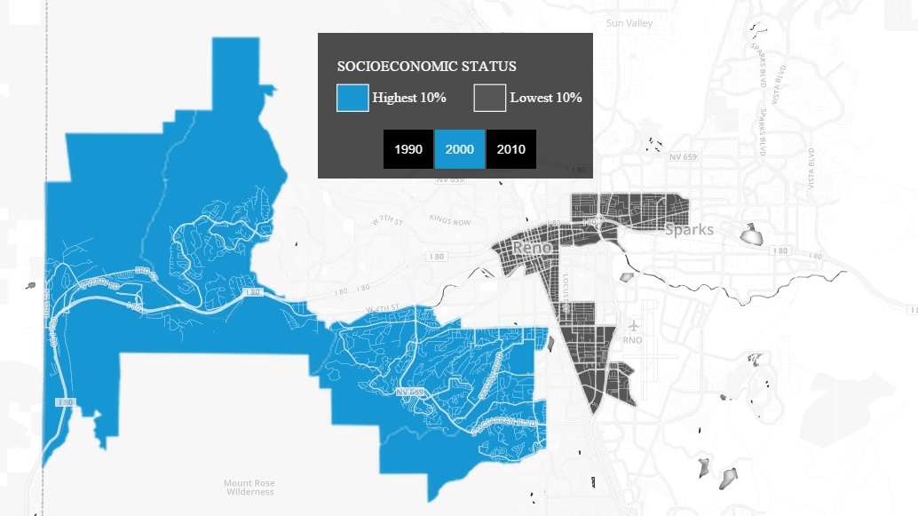
Urban.org

Slide 8
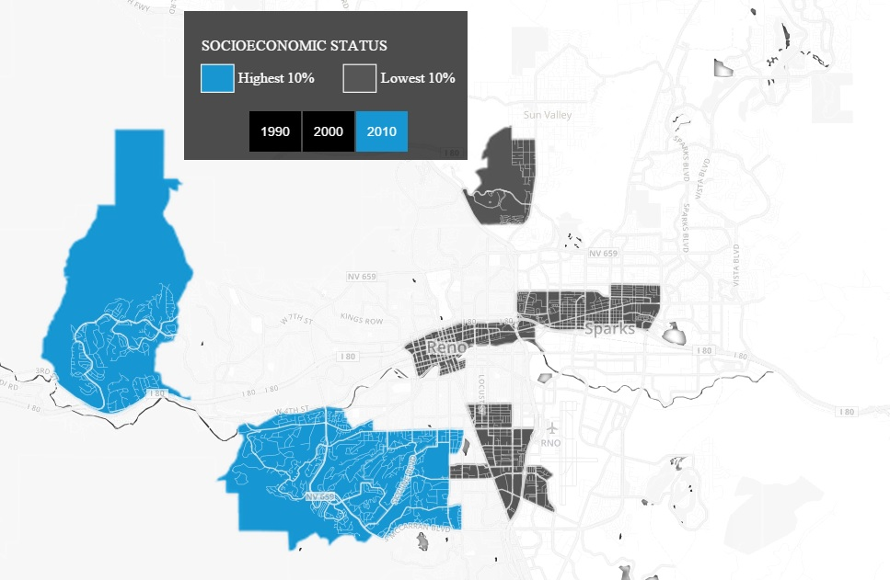
Urban.org

Slide 9
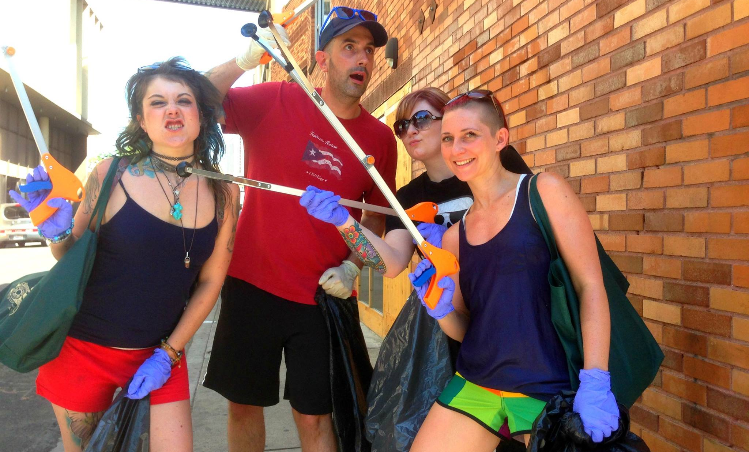
Care for the Streets
KTMB.org

Slide 10
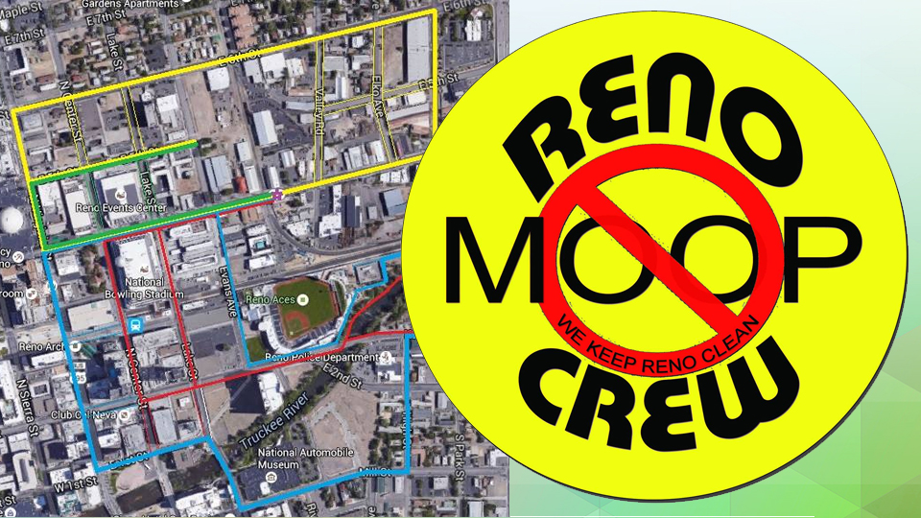

Slide 11


Slide 12
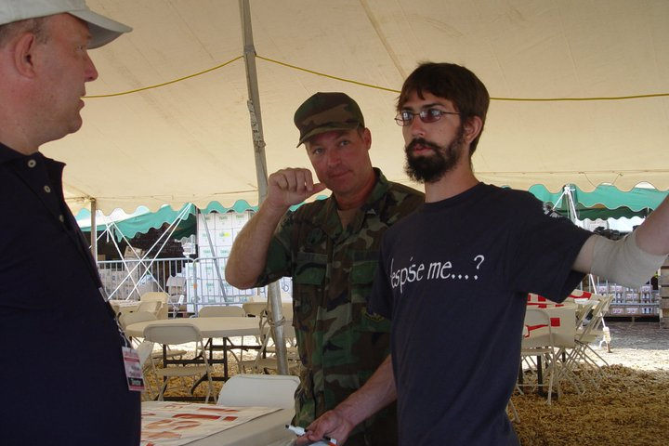
Deal with People

Slide 13
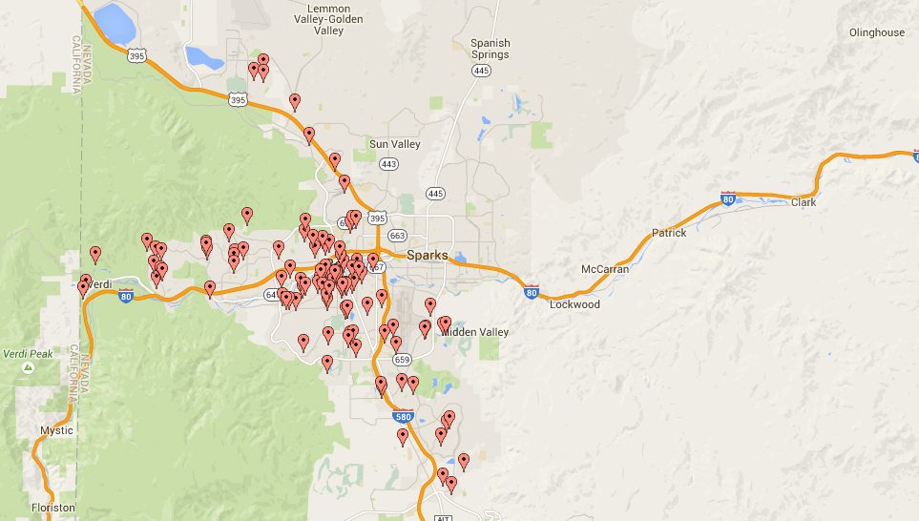
Neighborhood
Advisory Board
Applications
From Reno
Public Records
NABs

Slide 14


Slide 15
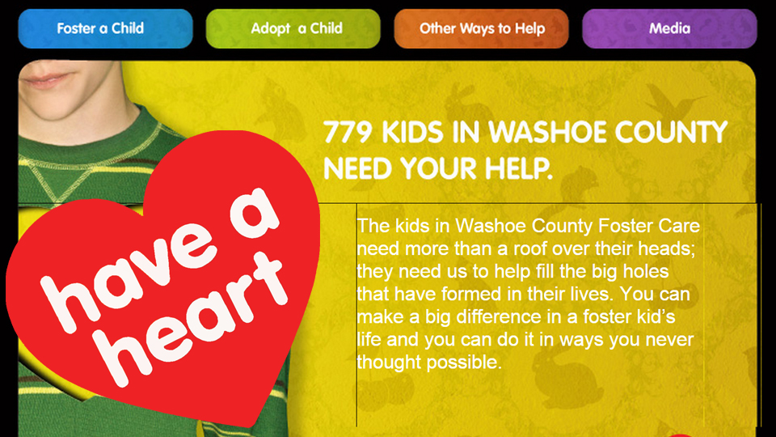

Slide 16
Presenter
Jay Kolbet-Clausell
775-391-0742
jay@renosparks.org

